Slide 1
Extraordinary Rhymes
Developed by James Yen

Slide 2
What is Extraordinary Rhymes?
Simple web app for constructing song lyrics
Rhyme suggestion
Highlighting song sections
Syllable counting | Bar lines
Specific emphasis on rap lyrics (hip-hop)
Mobile friendly
Targeted toward both amateur and professional songwriters
Just a tool

Slide 3
Project Goals
Gain a better understanding of how to write web apps (all that async stuff)
Mostly scripts and events
Discover things about song lyrics I hadn’t seen before
Have fun

Slide 4
Project Justification
Why?
I like music, and song lyrics fascinate me.
Have I done this before?
I’ve never really designed a web app from scratch before.
It’s a challenge to maintain multiple things at once.
Curriculum?
JavaScript, encounters with async, Interaction Design.

Slide 5
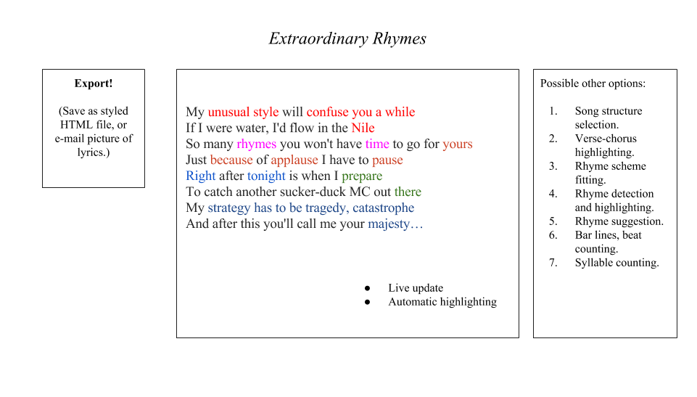

Slide 6
Demonstration!

Slide 7
Project Challenges
Have never designed a web app before. (Except for that one time.)
Web apps aren’t designed like console programs (they aren’t always running).
Async!
Rehash of the above.

Slide 8
Punch List
Kill this async thing
Convert my web app from synchronous requests to asynchronous requests
Ajax

Slide 9
Questions, comments, clarifications?

